Slide 1
Week 15 Review
I encourage you to review your class notes every week …

Slide 2
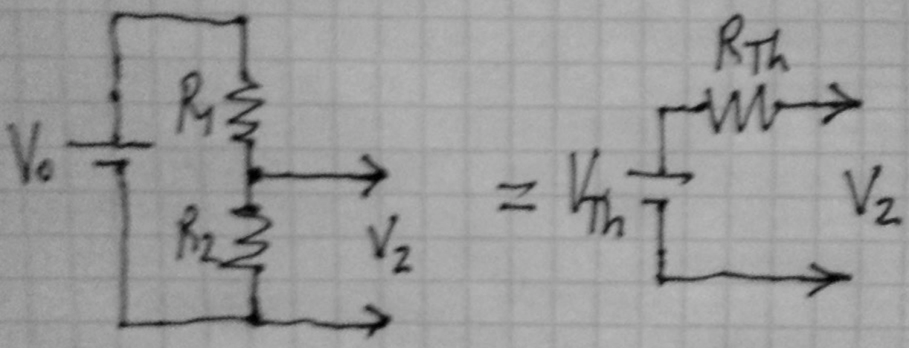
Group Quiz (algebra warmup)
What is the Thevenin model of a voltage divider?
In other words relate the variables:
Recall the rules? (see Wikipedia “Thevenin’s Theorem)
A voltage divider is called “stiff” if adding a load (across V₂) doesn’t significantly change its voltage
I.e., stiff means Z_{load} >> R_{Th}

Slide 3
Group Quiz (calculus warmup)
Connect a load resistance R_{L} to V₂. What value of R_{L} will dissipate the most power?
First consider two extreme cases and show the power P_{L} is zero when R_{L}=0 and R_{L} = infinity
Hint 2: Which circuit above should you use?
R_{L}

Slide 4
Group Quiz (calculus warmup)
What value of R_{L} dissipates the most power?
Sad fact:
The maximum power transferred is only 50% of power produced by V_{th}.
R_{L}
This condition is called “impedance matching”

Slide 5
Class objectives
Introduction to electronics
How to design, built, and understand simple circuits
How to combine simple circuits to achieve useful behaviors
What kinds of things are easy (and hard) to do with electronics
Practice construction and debugging skills
How to make your designs work
How to figure out how other’s designs work (and don’t work)
Learn where to find resources to learn and do more with electronics
Anything we should modify???
Notes:
The constraints of a language need not be handcuffs on our creative expression – consider what poets can express within the tighter constraints of poetry vs ordinary language. The constraints of electronics are about as limiting as a 2-d canvas is to a painter or photoshop to a digital artist. My learning objective for each of you is to create some nice electronics art – make some novel paths for electrons to flow.

Slide 6
Learning objectives – should we modify?
Because low voltage electricity doesn’t behave in intuitive ways (like baseballs, raindrops, …), we have to learn (and appreciate) an appropriate electronics language
Schematics are a formal language with unique and powerful grammar, syntax, and semantics + context (structure, symbols, and meaning)
A good language helps us discover, explore, and communicate ideas
Learning a language requires lots of practice
Fluency involves thinking in the language, not just translating
Abstractions/representations avoid solving Maxwell’s equations
Just as computers obey binary instructions, we generally seek more abstract, “higher level”, representations of their states
Appreciate the art of electronic engineering
Find synergy in imagining, visualizing, and creating new devices
Almost every class I draw schematics on the board … do you copy them and draw others?
How can you expect to learn a language with out practicing it?
Notes:
The constraints of a language need not be handcuffs on our creative expression – consider what poets can express within the tighter constraints of poetry vs ordinary language. The constraints of electronics are about as limiting as a 2-d canvas is to a painter or photoshop to a digital artist. My learning objective for each of you is to create some nice electronics art – make some novel paths for electrons to flow.

Slide 7
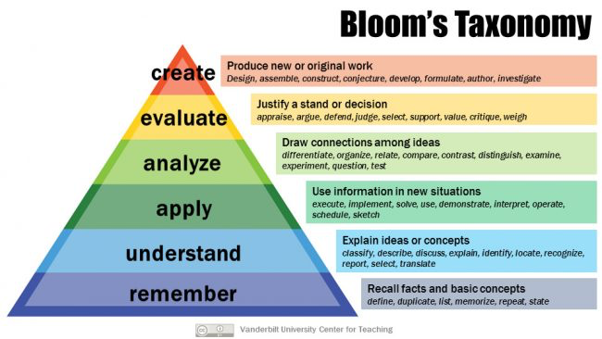
Education theory:
Reductionism of the cognitive domain
http://thesecondprinciple.com/teaching-essentials/beyond-bloom-cognitive-taxonomy-revised/
http://www.utar.edu.my/fegt/file/Revised_Blooms_Info.pdf

Slide 8
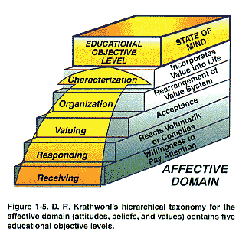
Reductionism of the affective domain
Studying electronics can teach you an awful lot about yourself
How do you learn?
How do you deal with uncertainty?
How do you use abstraction?
The more you struggle here, the less you’ll struggle elsewhere to achieve higher intellectual growth

Slide 9
Surrender to Jesus!!
Studying electronics can teach you an awful lot about yourself
How do you learn?
How do you deal with uncertainty?
How do you use abstraction?
The more you struggle here, the less you’ll struggle elsewhere to achieve higher intellectual growth

Slide 10
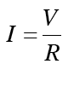
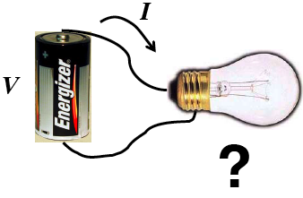
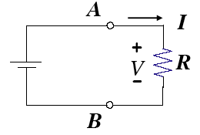
First activity
Batteries and bulbs → general principles
Circuits are necessary for current flow
Series circuits have the same current
Parallel circuits have the same voltage
Later we learned …
A device’s V and I are related by the I-V curve
Resistors are linear
Diodes are horizontal and vertical, characterized by V_{forward} (the ”knee”) and V_{zener}

Slide 11
Algebraic Rules
Key rules
Ohm’s Law: V = IR
Watt’s Law: P = VI = V²/R = I²R
Kirchoff’s Voltage Law (KVL): ΣV=0 around any loop
Kirchoff’s Current Law (KCL): ΣI=0 into or out of any node
I-V curves are a useful way to characterize devices
Thus are often called “characteristic curves”
Diodes are electrical “check-valves” – allow current flow in one direction
Resistors turn current into voltage and turn voltage sources into current sources … (please read that sentence again …)
BJTs have 3 terminals → 2 circuits, i_{B} controls I_{C}, in the linear range, i_{C} = h_{fe}I_{B} , but often we use BJTs as switches in saturation
Start with simple (linear) models, modify as necessary if those models don’t work

Slide 12
Memorize this!!
What’s V_{b}? (I.e., V_{b}-V_{c})
This is the common “voltage divider” equation, which you’ll be using over and over …
Note: there’s a lot of implicit information in this game …
Writing (and rewriting) notes will help you identify what you don’t know, …

Slide 13
Engineering vs. physics
We’ll take a hierarchical, reductionist, engineering approach
That means we’re not interested in understanding every step to ever deeper levels of analysis (physics), but in doing minimal work and understanding to get the job done.
Let’s break the task into 5 parts:
Design – figure out how and what to do
Prototype – do it (and redesign if it doesn’t work the first, 2nd, … times)
Construction – make it clean, adequately robust, and safe
Validation & Reflection – what worked, what didn’t?
Documentation – write a report (and do more meta-cognition)
Ready to break up Design into pieces?
Notes:
Recall in the introductory, online materials, I said that like a foreign language, there isn’t a unique place to start. We’re jumping in to conversation now. Expect that you’re not going to understand everything, but please slow me down, ask questions, so more of this makes sense. We’ll come back later and review this process multiple times …

Slide 14
Lab 1: Building a LED Nightlight
We took a hierarchical, reductionist, engineering approach
That means we’re not interested in understanding every step to ever deeper levels of analysis, but in doing minimal work and understanding to get the job done.
Let’s break the task into 4 parts:
Design – figure out how and what to do
Prototype – do it
Construction – make it clean, pretty, robust, and safe
Validation & Reflection – did it come out the way it was designed?
Documentation – write a report (and do more meta-cognition)

Slide 15
Some Lessons
Practice writing lab reports – an important writing format (genre)
The document should tell a story … there should be a logical flow: what we want to do, how we did it, what happened, and what have we learned …
We learn about electronic devices by building circuits with them and characterizing those circuits, e.g., measuring current in a series resistor, etc.
Every electronic component is a mystery box at some level

Slide 16
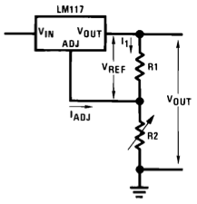
DC Power Supply design
Week 2
Based on the App Note
V_{out} = V_{Ref} * (1+R₂/R₁) + i_{Adj} * R₂
From the specs, i_{Adj} < 50μA & V_{ref} = 1.25V
Pick i₁ ~ 20* i_{Adj} ~1mA to ignore last term
R₁ = 1.25V/1mA = 1.2kΩ
12V = 1.25(1+R₂/R₁) → R₂/R₁ = 9.
A 10kΩ pot is close
So we’ve designed a part of our power supply
The reductionist approach to engineering – divide and conquer
What’s missing?

Slide 17
Design -> Prototype -> Construction
Next step is to validate our design by building a prototype
The engineering trade-offs in a prototype are ease and flexibility over robustness – because the prototype only needs to work long enough to prove the concept (and to explore revisions that might improve performance)
Implicit in each step is testing and debugging
What are the expected characteristics?
How will we know if its working or not?
If not, how will we troubleshoot the problem(s)?

Slide 18
Data logging with Arduino
Week 3
We must co-develop 3 things
“Hardware interface” to the Arduino
“Software interface” run on the μC to query the hardware interface and generate data
“Data interface” to interpret and reduce the data, easiest written in high level languages like Matlab on a host PC
Hardware interface functions
Protect the μC from dangerous voltages, transients, …
Ensure the signals you wish to measure are within a safe range
Ensure that noise doesn’t unduly contaminate the signals of interest
May include triggering and other state signals

Slide 19
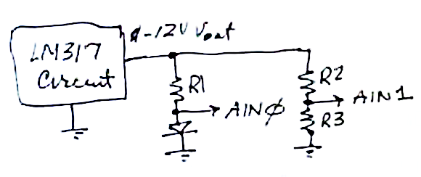
Hardware interface design
We can use the variable V_{out} of the LM317 through R₁ to vary the current through the LED: R₁ = 12V/10mA ~ 1kΩ
V_{out} of the LM317 ranges from ~1.25-12V … how do we map that into 0-4.5V? Voltage divider:
V_{out} = V_{in} * R₃/(R₂+R₃) so
4.5 = 12 * R₃/(R₂+R₃) … one equation and 2 unknowns
We haven’t discussed impedance matching yet (but we will), the idea is that R₃ has to be much smaller than the impedance of the Arduino’s A1, and big enough to not waste power. Z_{A1} >> 10kΩ, so let R₃ = 10kΩ – a 2nd equation
→ R₂ = 17kΩ (exercise: check the algebra). If you have a couple of 33kΩ you could make that, I used a 20kΩ so V_{in} = 3.0*V_{out}

Slide 20
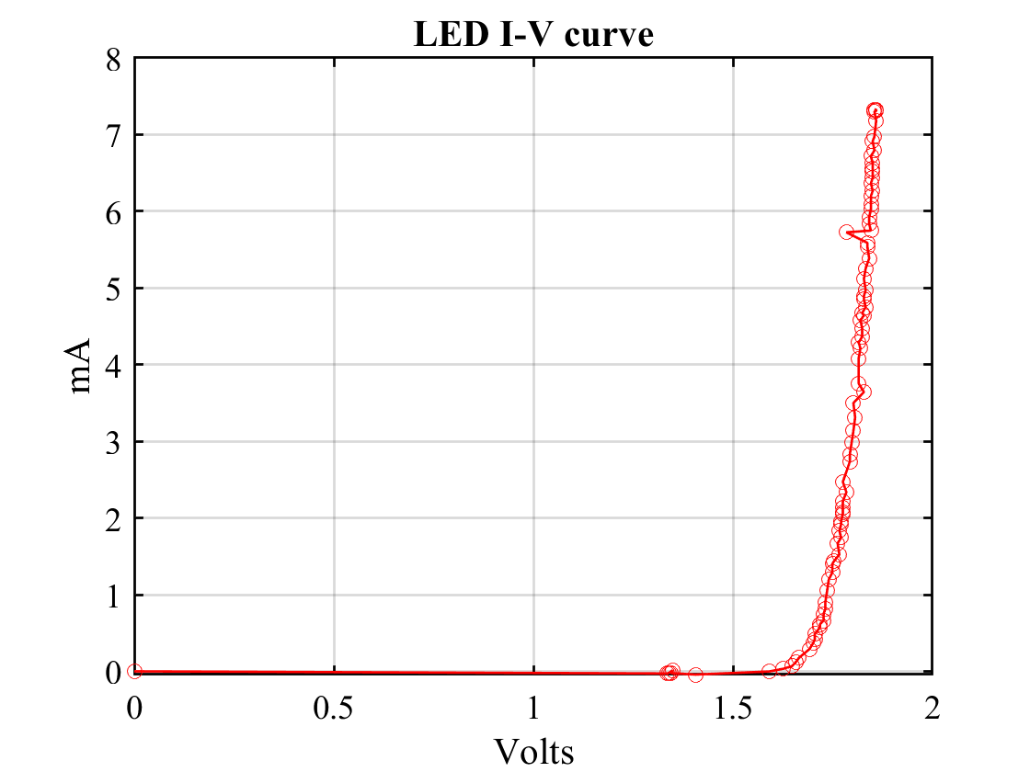
My data
Wouldn’t want to do this without automation!

Slide 21
Know your tools …
As I file down my wire cutters so they work better, here’s an example of someone who knows their tool …
https://www.youtube.com/watch?v=o6rBK0BqL2w
https://www.youtube.com/watch?v=2xjJXT0C0X4

Slide 22
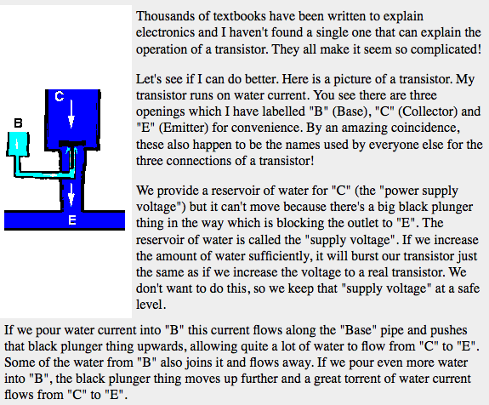
Transistor as a valve
Week 4
A small base-emitter current controls a much larger collector-emitter current
http://www.satcure-focus.com/tutor/page4.htm (google “transistor tutorial” for many other explanations)

Slide 23
Transistors: Recommended strategy
If you’re at all like me, it will take lots of effort (i.e., years) to wrap your brain around transistors
Memorize the basic nomenclature – can’t avoid it
Try to understand intuitively the most basic model by reading and rereading descriptions from many sources
The voltages that matter are relative, measured between the pins. The transistor doesn’t know or care what its “voltage” is relative to ground or a distant reference
The big challenge is figuring out what those relative voltages are in dynamic circuits

Slide 24
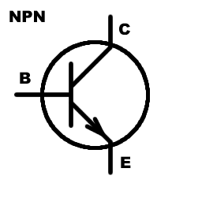

BJT Golden Rules
There are no golden rules … there are many configurations and possibilities with BJTs…
The base-emitter often acts like a diode
If V_{be} < ~0.6V then i_{c} ~ 0 and the transistor is “cut-off”
If V_{be}~0.6-0.7V (forward biased diode) and i_{c} = h_{fe} * i_{b} , then the transistor is “active”
If V_{be}~0.6-0.7V (forward biased diode), but i_{c} < h_{fe} * i_{b} , then the transistor is “saturated”
Forcing V_{be}>0.7V will likely destroy the device quickly
The transistor will lower its collector-emitter voltage in order to satisfy (2b) But it can’t go below V_{ce}~ 0.1-0.3V
Like diodes (e.g., LEDs), external components (e.g., R’s) are generally needed to keep base and collector currents at safe (for the device) limits
…

Slide 25
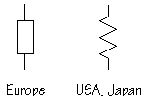
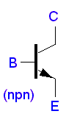
Simplest 1-transistor circuits
Week 5
Fixing or floating various terminals gives various circuit properties (and a whole lot to remember and get confused about), e.g.,
fixed
out
fixed
out
R₁
i_{out} < βi_{in}
i = V_{e}/R
out
fixed
in
G = -R₁/R₂
in
in
fixed
out
Z_{out} = Z_{in}/β
R₂
fixed
fixed
Switch
Follower
Current source (sink)
Amplifier
And from these 4 abstractions come 2 transistor circuits …

Slide 26
Followers, Mirrors, …
Vb = Ve + .6V
Called a follower because when the base-emitter is forward biased (V_{be}=.6), ΔVout = ΔVin, i.e., AC voltages follow
Two matched transistors with the same V_{be} should have the same i_{c}.
Current sources, push-pull amplifiers, Darlingtons (super-betas), amplifiers and differential amplifiers were some other circuits we learned to recognize
I_{out} = I_{REF}
Independent of V_{out}

Slide 27
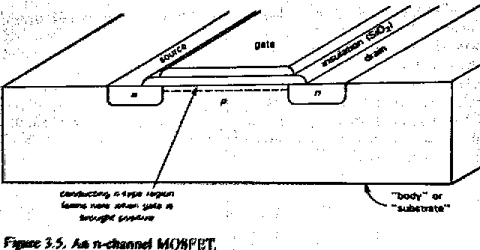
How the n-FET works
Conduction between Source and Drain is controlled by E field between Gate and substrate
Conduction can be bidirectional
4 terminal device, though generally substrate connected to S or D
~zero gate current (R_{gate} ~10¹⁴)
https://en.wikipedia.org/wiki/Field-effect_transistor has animations
https://en.wikipedia.org/wiki/Moore%27s_law#Recent_trends

Slide 28
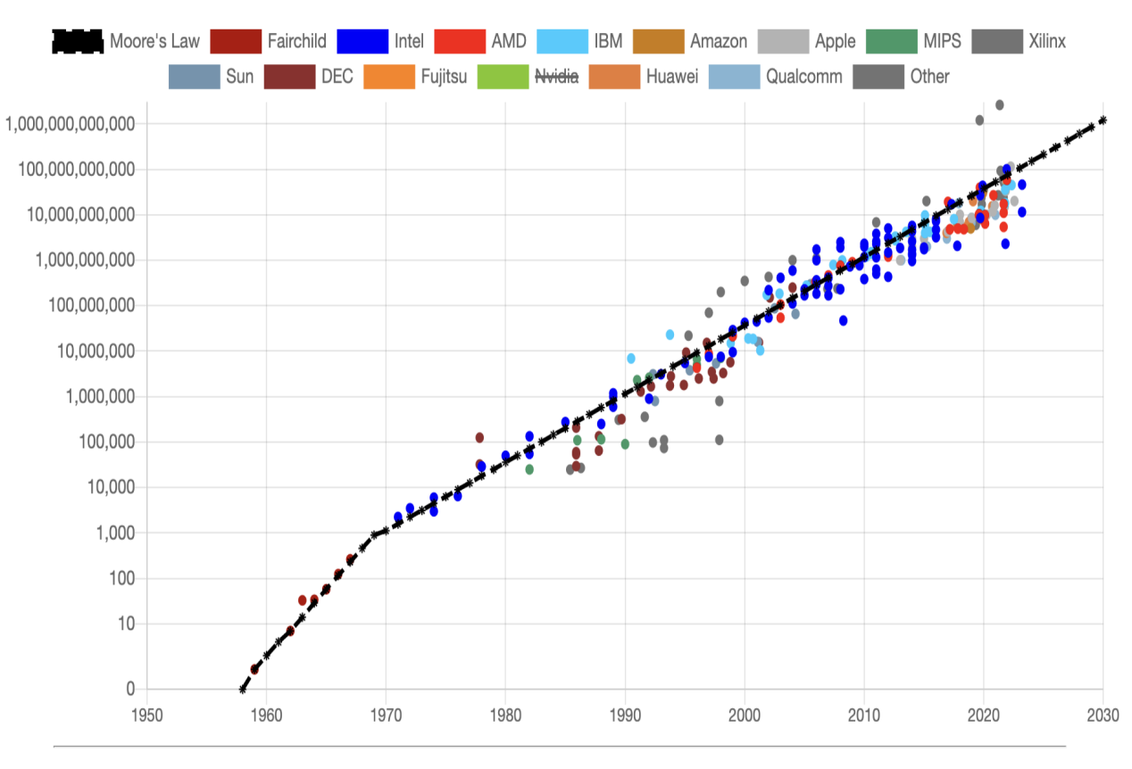

Slide 29
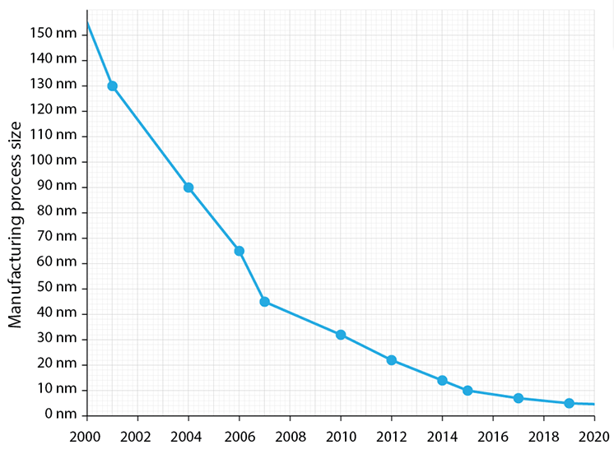
Diminishing returns

Slide 30
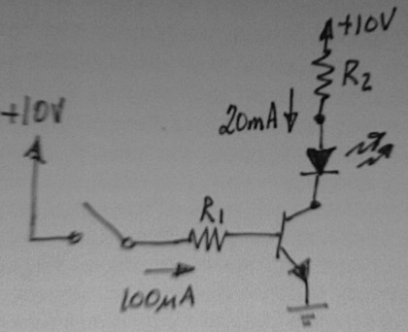
Transistor Switch & Impedances
What are the input and output impedances of this circuit?
What does that mean??
Why should we care?
Z_{in} = V_{in} / I_{in}
= 10V/100uA = 10⁽¹⁻⁽²⁻⁶⁾⁾ V/A
= 10⁵ = 100kΩ
Z_{out} = V_{out} / I_{out} = 10V/3.5mA = 2.9kΩ
More circuit characteristics:
Voltage gain = V_{out} / V_{in} = 1
Or?? 10V on R1 makes Vc → ~0.3; 0V on R1 makes Vc→ 10V
Power gain = P_{out} / P_{in} = (Z_{in}/Z_{out}) = 100K/2.9K ~33
So this circuit amplifies power by lowering Z, it is a thus a “trans-impedance amplifier”
3.5 mA
2N3904
100μA

Slide 31
Capacitors in Detail
Capacitors store (integrate) charge
That makes circuits with them nonlinear, dependent on the past
Differentiate both sides of the static description:
⇒ $\frac{dQ}{dt}≝i=C\frac{dV}{dt}$
Look strangely familiar?
How do you convert this differential equation into an algebraic equation??
What if dV(t)/dt = λV(t)? Are there functions such that differentiating has the same effect as multiplying (scaling or shifting)?
i
$$Q≝CV$$
Slope = C
$$\frac{dV}{dt}$$

Slide 32
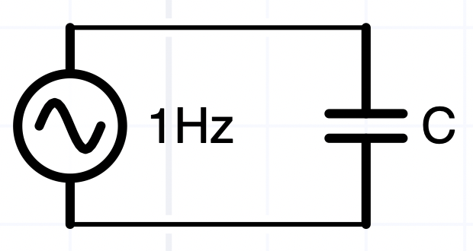
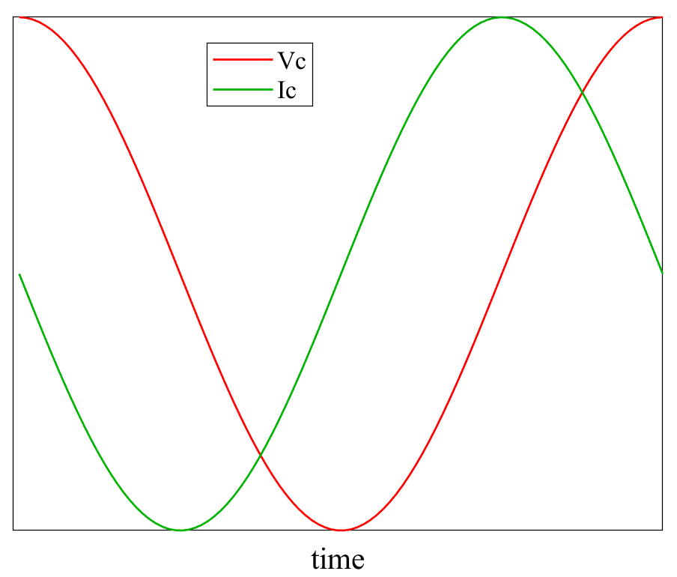
What’s the current?
i(t)
V(t)
If V(t) = V₀ then i=0 after the capacitor charges to V_{0,} ie. dV(t)/dt=0V(t) → V= V₀ = const is a solution, albeit a boring one
If V(t) = V₀cos(ωt), then
i = CdV/dt = -Cωsin(ωt)
With foresight, we can also write i = Cωcos(ωt+π/2)
The voltage and current are phase shifted
We’ll have to keep track of both amplitudes and phases when dealing with AC voltages

Slide 33
Summary (KEY SLIDE!!)
That was some gnarly math, so let’s summarize and conceptualize …
If the voltages change sinusoidally, then instead of calculus, we can treat a capacitor’s impedance (Z = generalized resistance to current flow) algebraically as a complex number
Z = 1/(jωC) = 1/(j2πfC), and it’s also frequency dependent
Complex impedances and numbers are a book-keeping trick, to deal with phase, which doesn’t exist in DC circuits.
We just need to follow the rules of complex algebra to get the right answers

Slide 34
Time vs. Frequency domains
It’s more common for us to think in the time domain, i.e., V(t), voltage plotted vs. time
Oscilloscopes usually operate in the time domain
Most circuit analysis is done in the frequency domain!
V(f) or V(ω) or V(s)* voltage plotted vs. frequency
Spectrum analyzers, and other instruments: network analyzers, impedance analyzers, display the frequency domain continuously in “real time”
Time domain behavior can be easy to predict from frequency domain analysis
Some modern digital oscilloscopes and analyzers can display both at the same time … (fun toys!!)
* https://en.wikipedia.org/wiki/Laplace_transform

Slide 35
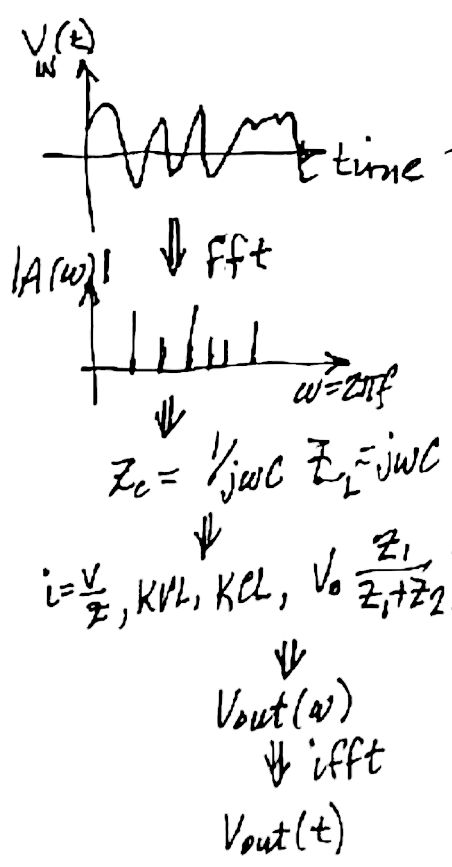
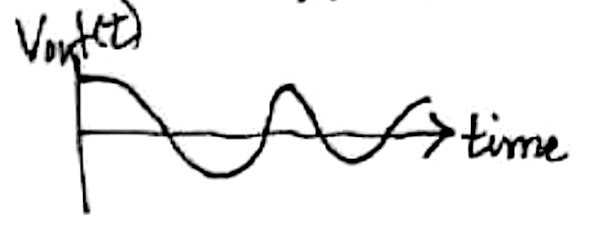
Time vs. Frequency domains
Imagine a complicated waveform, V_{in}(t) passing through a circuit of R’s, C’s, (and L’s) – what’s V_{out}(t)?
It’s really hard to tell … you have to solve differential equations for i_{C} = CdV/dt and V_{L} = Ldi/dt … the output depends on previous inputs in complicated ways …
Or you can solve algebraic voltage divider, KVL, KCL equations for each sine wave component, using Z_{C} = 1/(jωC) and Z_{L} = jωL.
Fourier transform V_{in}(ω) = fft(V_{in}(t)) where fft = Fourier transform
Compute impedances at each frequency, ω, solve the circuit algebraically for V_{out}(ω)
V_{out}(t) = FT⁻¹(V_{out}(ω)) using the inverse Fourier transform (e.g., V = ifft(fV) in Matlab)
Vout = abs(V) with phase shift = angle(V)
L

Slide 36
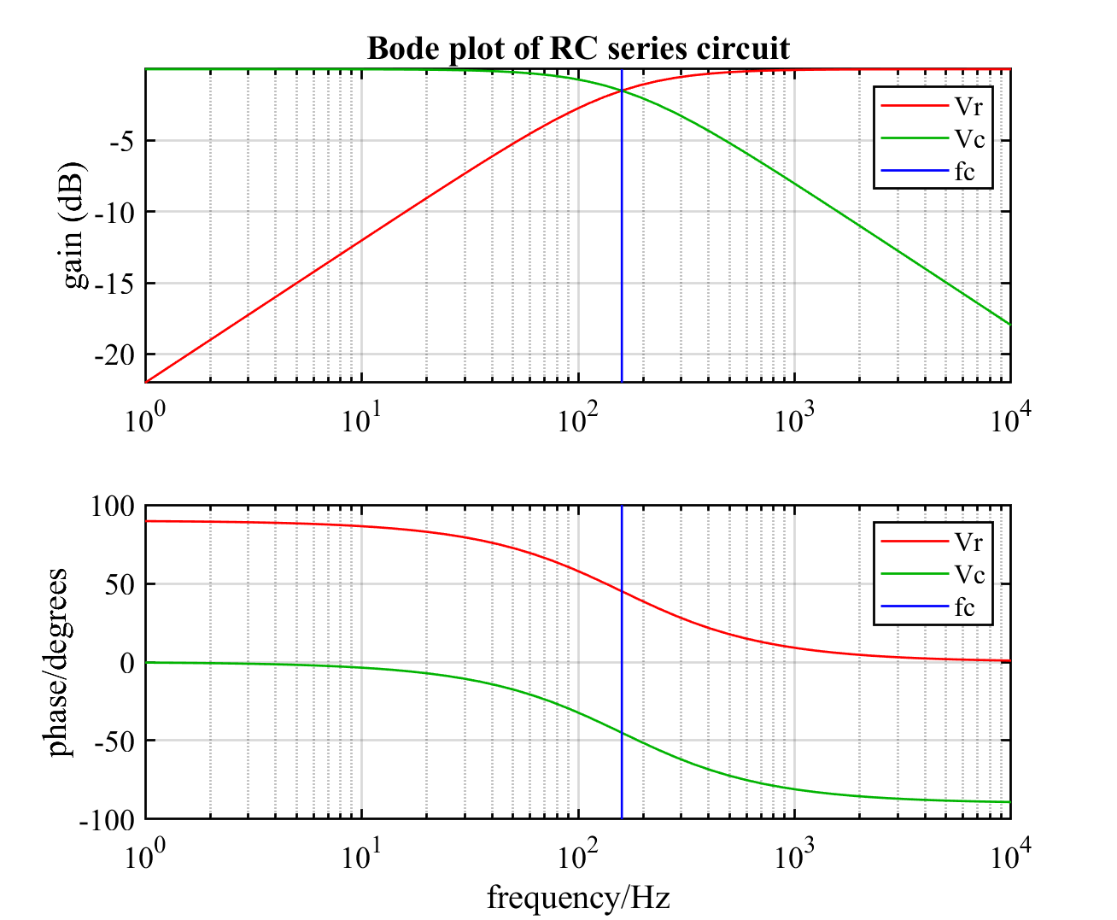
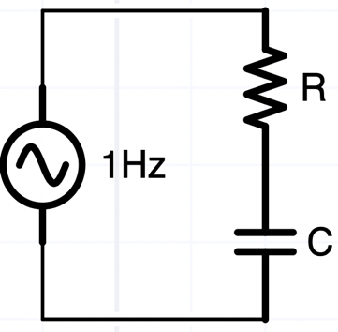
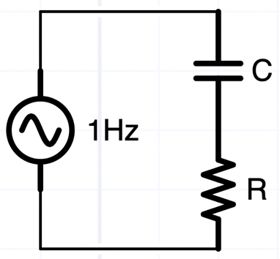
R-C circuits are frequency “filters”
“Low pass filter”
“High pass filter”
Vout/Vin
Vout/Vin
Note: Just changed the top plot to:
semilogx(f,10*log10(abs([Vr Vc])/Vo)); ylabel('gain (dB)')

Slide 37
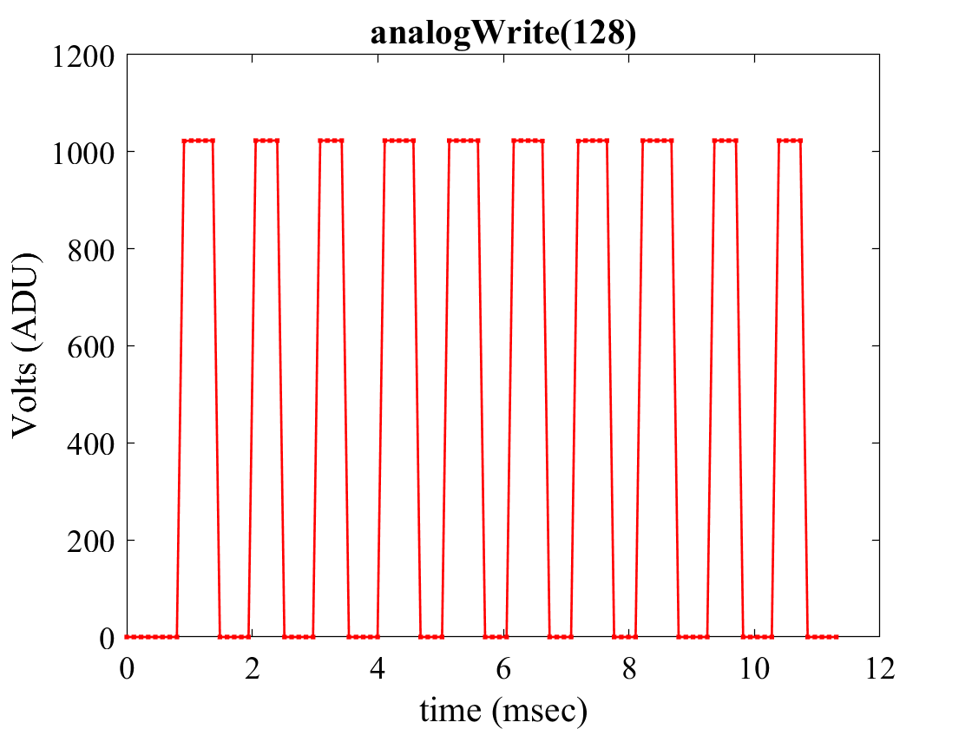
Arduino AnalogWrite()
Doesn’t generate a DC voltage, but a fast-switching (970Hz) AC voltage with average value proportional to the pulse width or duty cycle – i.e., pulse with modulation (PWM)
A low pass filter that passes DC (0 Hz) while attenuating the PWM frequency will convert the PWM voltage to analog DC

Slide 38
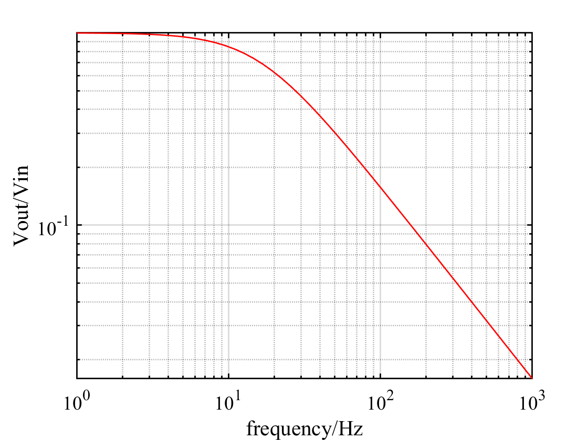
PWM attenuation vs. settling time
Experimenting with different R’s and C’s (mostly R’s since we don’t have many C’s) → there’s a trade-off
Attenuating PWM noise increases settling time (and the rate at which we can change voltages)
Do we have to compromise with either PWM noise for faster settling or a quieter voltage that can only be changed slowly?
Think about this in the frequency domain
← Settling is here
Want higher gain
PWM noise is here
want lower gain →

Slide 39
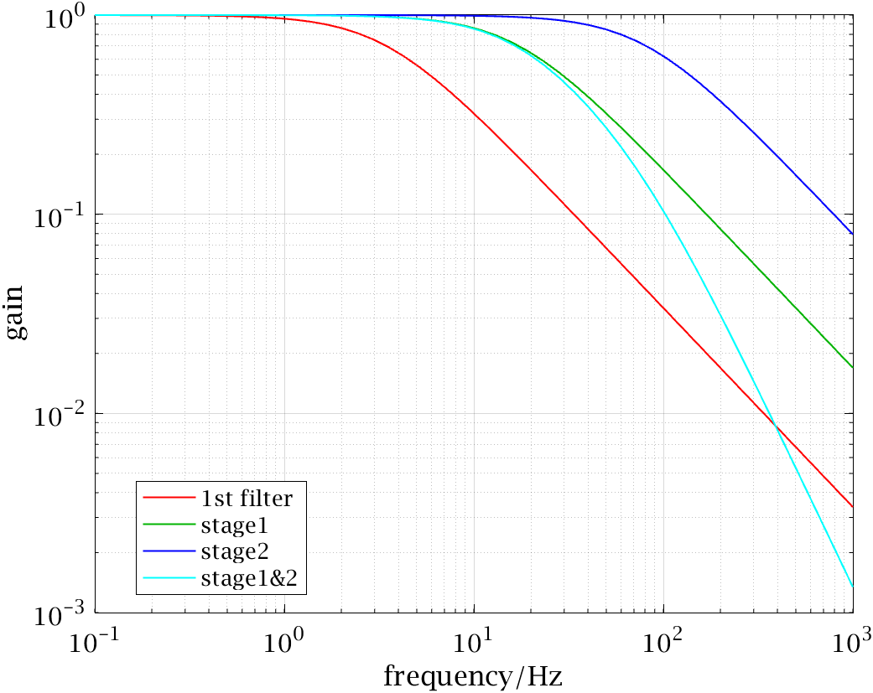
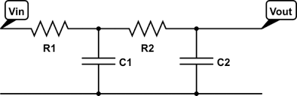
2nd order (cascaded) filters
-20dB/decade
% first order filter that works
R = 100e3; C = 1e-6; Vo = 1;
j = sqrt(-1);
ff = logspace(0,3)';
w = 2 * pi * ff;
Zc = 1 ./ (j*w*C);
Vc0 = Vo * Zc ./ (R+Zc);
% 2nd order design:
R1 =1000; C1 = 10e-6;
Zc1 = 1 ./ (j*w*C1);
Vc1 = Vo * Zc1 ./ (R1+Zc1);
R2 = 20e3; C2 = .1e-6;
Zc2 = 1 ./ (j*w*C2);
Vc2 = Vc1 .* Zc2 ./ (R2+Zc2); % Vc1 is input
figure;
loglog(ff,abs([Vc0 Vc1 Vc2]));
axis tight; grid
ylabel('gain'); xlabel('frequency/Hz')
legend('100k+1uf','1k+10uf','2 stage')
-40dB/decade

Slide 40
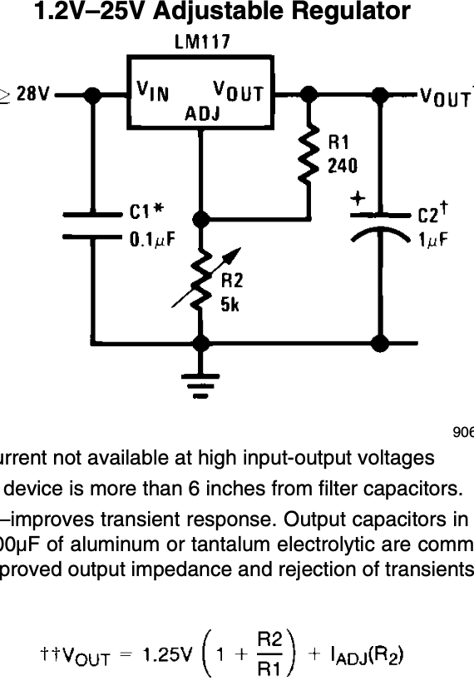
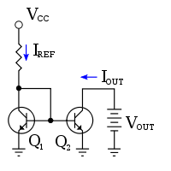
Automating LM317 How does R2 control V_{out}?
R2 sinks the current from R1 (i_{R1} = Vref/R1) and the ADJ pin … so what if we provide a parallel current sink ?
Keeping current i from flowing through R2 lowers the the putput voltage by i*R2
Recall the current mirror (https://en.wikipedia.org/wiki/Current_mirror)
If Q1 and Q2 are identical then their collector currents should be identical, even Vcc ≠Vout
Vout = Vadj, the ADJ pin of the 317
Vcc = the PWM output, so I_{ref} = V_{PWM}/R
Impedances and loads
I_{ADJ} can be as much as (11-1.25V)/R2 ~ 1mA, so we need I_{REF} = 1mA ~ (5-0.6)V/R_{REF}
→ R_{REF} ~ 4kΩ
Our 2nd stage PWM filter has R=22k, so this will short out the filter (remember R_{load} >> Zfilter)
What to do?

Slide 41

Schematic
Take the time to draw this and think about what each component does
BTW, at this point, I had drawn multiple schematics, but hadn’t tried to put them together because I hadn’t built them together … and anticipate that some parts may change
Voltage
divider
Arduino
Nano
22k
A0
+5V
10k
Emitter
follower
D5
+12V
GND
Low pass filter
Current mirror
DC Power Supply

Slide 42
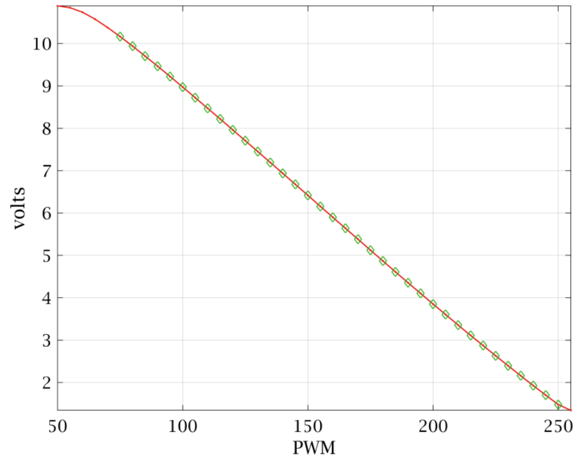
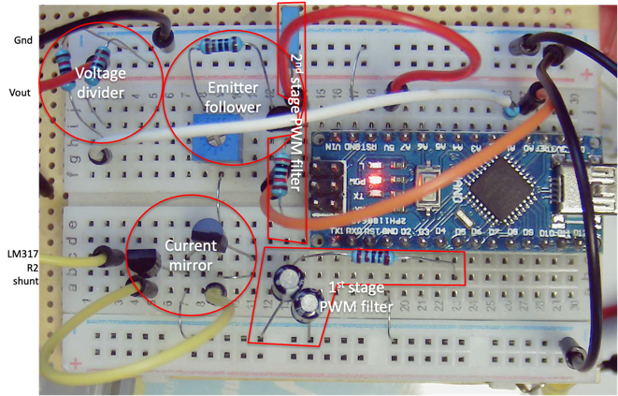
Arduino LM317 controller
SW interface can be a “wrapper” around the p <pwmVal> command
Polyfit is more compact than a lookup table
function [pwmVal] = volts2pwm(volts, ard)
% function [pwmVal] = volts2pmw(volts, ard)
% return pwm value corresponding to volts for LM317 arduino ...
% if a serial port is passes as 2nd arg then sends p command
pv = [-0.0526 0.9434 -24.7402 281.5264]; % substitute your pv values
pwmVal = round(polyval(pv, volts));
pwmVal(pwmVal < 0) = 0;
pwmVal(pwmVal > 255) = 255;
if nargin == 2
writeline(ard,['p' num2str(pwmVal)]);
end
end

Slide 43
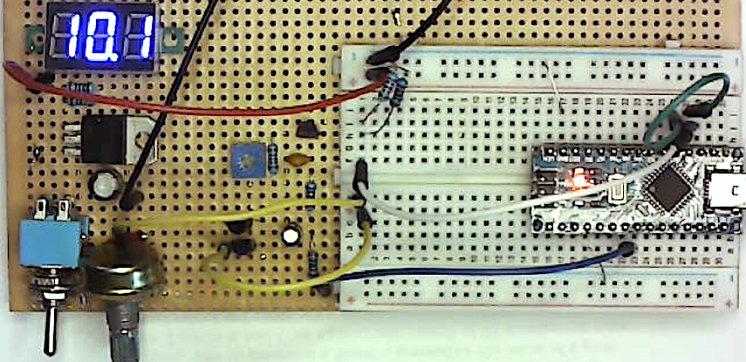
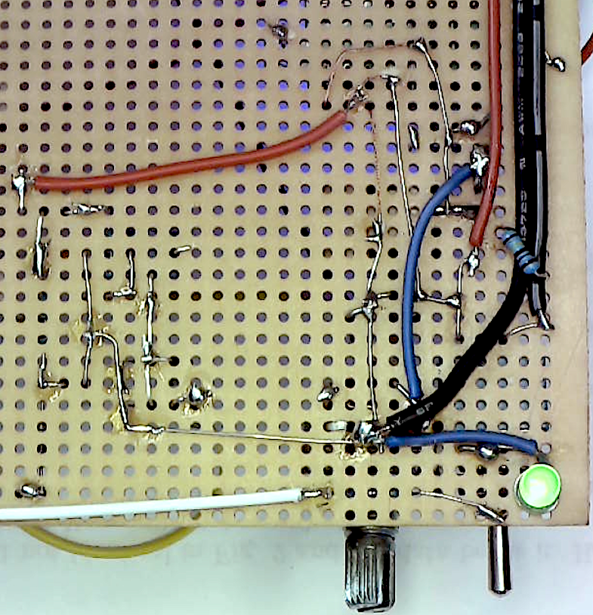
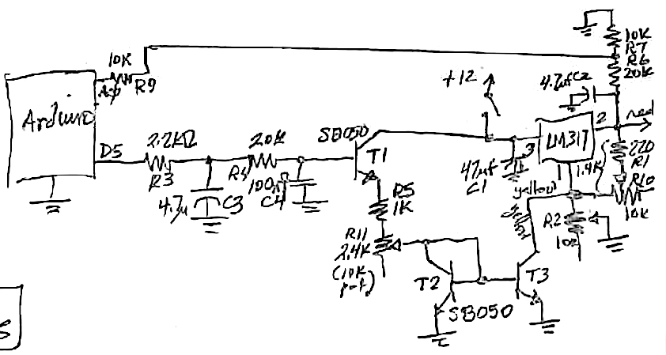
Soldered
Notes:
Should rotate 180 degrees … picture is upside down!

Slide 44
Practical tips for building the F-Gen
Make sure you’re working on the right side of the board …
Solder the flat parts first, the wobbly parts last
Resistors (measure each value before soldering), then sockets, header pins, small caps, big caps and last, pots
Testing …
First eyeball solders looking for good contact angles and no bridges
Test with ohmmeter … (what? Look at the schematic)
Apply voltage and use voltmeter to test the socket (BEFORE plugging in the IC)
May need to gently, carefully bend the IC to align all pins … place over socket (with power off); verify good alignment (no pins are bending), and press firmly down
If you need to pull the IC later, use a fine screwdriver to wiggle each end up slightly – don’t try to pull it up from one end with your fingers …
Before applying power, plan what test(s) you’ll do to verify it is working … what do you expect, what constitutes pass or fail?
Turn on power and feel that no components are getting hot … (repeat after a minute)
Take your measurements and record results

Slide 45
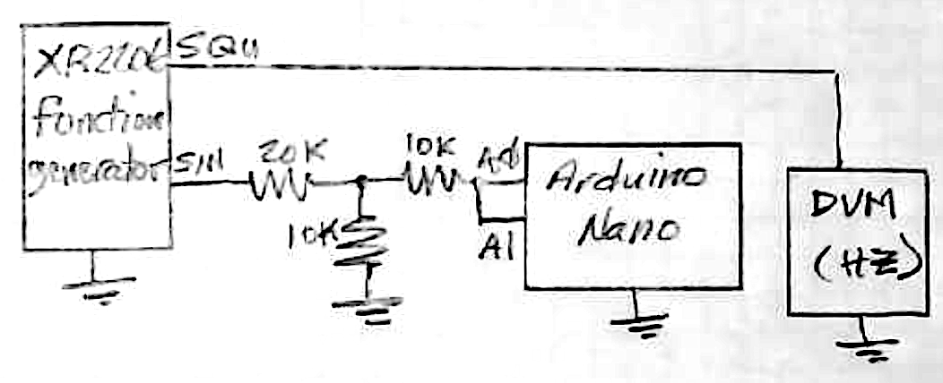
Using the F-Gen
Start all pots near center – too far one or the other way and the circuit may not oscillate
Test DC and AC voltage with your DVM and always use voltage dividers and 10k series resistors to connect to Arduino
Stable triggering, along with measuring frequency, amplitude, and phase can be done in oscope
Even though A0 and A1 are connected, the measured voltages are different – because they’re measured at different times
Time shifting or “deskewing” can be done in the time domain (using spline) or in the frequency domain using (complex number) multiplication, resulting in an appearance of simultaneity

Slide 46
Automating the function generator
Frequency control pots sink around 0-1mA, just like the LM317’s R2 – so we can use the same circuit for automated control
The jumpered frequency ranges aren’t convenient, so we modified C (using series and parallel C’s) to span ~ 30Hz - 1800Hz without moving the jumper
Avoiding aliasing at frequencies > f_{Nyquist} = sample frequency/2
Learned about “badly conditioned” polynomials, and how “normalization” – setting the domain and range closer to the origin – fixes it

Slide 47
Bode Plot
Whereas the evolution of oscope1.m to oscope3.m added functionality, refactoring oscope3 → oscope4 changed the implementation while leaving the function the same – to manage complexity differently
Instead of documenting key steps (like “make sure to set Fourier deskewing”), automating execution is a better guarantee these will happen, i.e.:
dat.skew.Value = 3; % set Fourier deskewing
dat.trimThresh = mean(dat.data(:,1));
Automated frequency sweeps measured circuit responses in the frequency domain that closely agreed with theory
We also observed non-ideal capacitor behavior, loading by the capacitor, and pitfalls and common mistakes in working with complex numbers.

Slide 48
Future
Beyond just learning about electronic components and circuits, you learned how to ”bootstrap” complex systems from simpler ones, how incrementally add complexity and apply strategies to troubleshoot, characterize, and modify their behaviors
You built a powerful toolkit to explore electronics, and started amassing experience and knowledge about how to use it more effectively
Variable DC power supply, function generator, data acquisition system, programmable current mirror controller, …
Most importantly, a mindset to know what might work, and methodology and finesse to prototype, modify, test, and iterate.
Proficiency with these intellectual and physical tools comes with practice
May the Force be with you!

